Slide 1


SimpleNet: A Simple Network for Image Anomaly Detection and Localization
Authors: Zhikang Liu, Yiming Zhou, Yuansheng Xu, and Zilei Wang
University of Science and Technology of China & Meka Technology Co. Ltd.
Presented by : Puneetha Dharmapura Shrirama
Notes:
Imagine you’re standing on a factory floor.
Every minute, thousands of products — like metal nuts, pills, or bottle caps — move quickly under cameras
Most of them look perfect, but hidden among them might be tiny defects that are almost impossible for humans to spot. Detecting these automatically, in real time, is the challenge called image anomaly detection.
Hello everyone! I’m [Your Name], and today I’ll be talking about a research paper called “SimpleNet: A Simple Network for Image Anomaly Detection and Localization” by Zhikang Liu and his team, presented at CVPR 2023.
What’s special is that it learns only from normal images — it doesn’t need examples of defects — yet it can still detect new, unseen anomalies with high accuracy.

Slide 2

Problem & Motivation
What is Anamoly Detection?
* Goal : Identify deviations from normal patterns
* Contraint : Trained on Normal Data only (One-Class Learning)
Why is it Hard ?
  Scarcity
  Unpredictability
  Real Time
Why Existing Methods Fail?
Reconstruction-based
Synthesis-based
Embedding-based
Why SimpleNet? Simple, Fast and Effective approach
Notes:
But anomaly detection is not that simple. Many models try to reconstruct images, but they can accidentally recreate defective parts too, missing the anomalies. Others generate synthetic defects, which often confuse the system. And pre-trained models,they are trained on general photos, don’t always match industrial images. Some embedding based approaches are also too heavy, making real-time detection difficult.
These challenges motivated the SimpleNet team to design a method that is both accurate and efficient for industrial and other domains

Slide 3



How SimpleNet Works ?
Feature Extractor
WideResNet50 (Frozen), Extracts features from Layers 2 & 3
2. Feature Adapter
Feature Adapter (No Bias), Projects features to target domain
3. Anomaly Feature Generator
Adds Feature-Space Synthesis q_{fake} = q_{normal}+$ε, where ε∈\sim N (0, 0.0152)$
4. Discriminator
Linear → BatchNorm → LeakyReLU
Key Insight: Synthesize anomalies in feature space, not image space!
Notes:
Now let’s look at how SimpleNet actually works.
It starts with something called a Feature Extractor — basically, a pre-trained model like ResNet that pulls out general features from normal images. This is a common step in image processing.
Next comes the Feature Adapter. Its job is to fine-tune those general features so they better match the specific data from the factory or industry we’re working with. This helps reduce what we call domain bias — so the model understands our type of images more accurately.
Then comes the clever part — the Anomalous Feature Generator. Instead of creating fake images, it adds Gaussian noise to the normal features. That means it makes small, realistic variations directly in the feature space — not in the image. This helps the model learn a clear boundary between what’s normal and what’s not.
Finally, we have a lightweight discriminator. Think of it as a quick decision-maker that learns to tell normal and abnormal features apart. Because it’s lightweight, the whole system runs fast enough for real-time detection.
The key takeaway here is this:
👉 SimpleNet doesn’t generate fake images — it generates anomalies in the feature space.

Slide 4
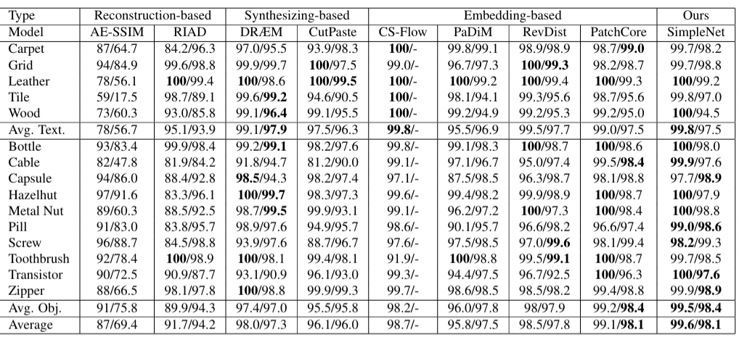
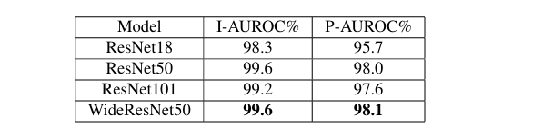
SimpleNet Results on MVTec AD
Table 1: Comparison of SimpleNet with state-of-the-arts works on MVTec AD
Table 2: Performanye under different backbones on MVTec AD

Slide 5
Core Idea of SimpleNet
99.6% I-AUROC > (State-of-the-Art on MVTec AD)
Reduces error by 55.5% vs. PatchCore
Reason 1: The Goldilocks Noise
Optimal Noise ( 𝜎 = 0.015 )
Creates a sharp decision boundary without overlapping normal data
Reason 2: Strategic Feature Selection
Intermediate Layers ( 2 & 3 )
Captures textures and local geometry instead of high level objects

Slide 6









Implementation: Bridging Industry and Medicine
Task Definition
Backbone: ResNet18
Trained ONLY on "Normal" scans (1,341 images) to learn the anatomical manifold of a healthy chest.
Utilizing Layer 3 features to capture textural information for medical pathologies superior to Layer 4.
Variable Experiment
Infrastructure
Noise Scale ($σ$): 0.015 (Standard) vs. 0.005 (Ablation).
Capacity: 3-layer Discriminator (512 units).
Batch Size: 16 (Reduced for GPU stability on 11GB VRAM cluster during full dataset runs).
Notes:
So, how does SimpleNet actually handle all those tricky problems? Well, first it tweaks pre-trained features—basically fine-tuning what it already learned from big datasets so it really understands our kind of factory images. That way, it knows the data it’s looking at.
Then, instead of trying to make fake defective images, it does something clever—it adds small variations directly in the feature space. This makes detecting real defects way more reliable.
And to keep everything fast, it uses a lightweight discriminator—a sort of quick decision-maker that tells normal from abnormal almost instantly.
The coolest part? SimpleNet isn’t just for factories. It can spot anything unusual, anywhere. So it works for one-class novelty detection in all sorts of domains.

Slide 7






Experimentation Comparison
.
The RGB Gap
Computational Cost
VRAM Stability
SimpleNet is hard-coded for 3-channel RGB. I modified the data loader to perform 1-to-3 channel expansion for grayscale X-rays.
Utilized High-Resolution (256x256) processing to capture pneumonia textures, increasing GPU memory overhead.
Batch size was reduced to 16 to maintain cluster stability on the 11GB VRAM hardware during full-dataset runs.
Notes:
So, how does SimpleNet actually handle all those tricky problems? Well, first it tweaks pre-trained features—basically fine-tuning what it already learned from big datasets so it really understands our kind of factory images. That way, it knows the data it’s looking at.
Then, instead of trying to make fake defective images, it does something clever—it adds small variations directly in the feature space. This makes detecting real defects way more reliable.
And to keep everything fast, it uses a lightweight discriminator—a sort of quick decision-maker that tells normal from abnormal almost instantly.
The coolest part? SimpleNet isn’t just for factories. It can spot anything unusual, anywhere. So it works for one-class novelty detection in all sorts of domains.

Slide 8

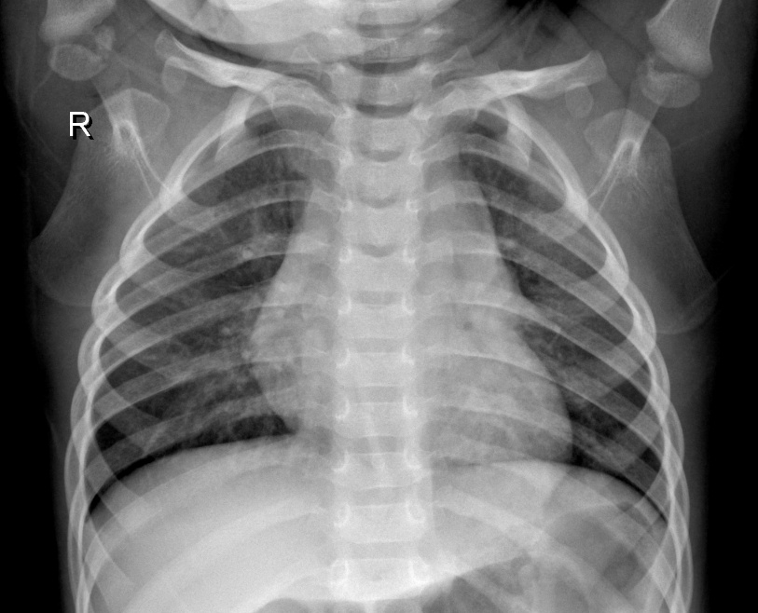
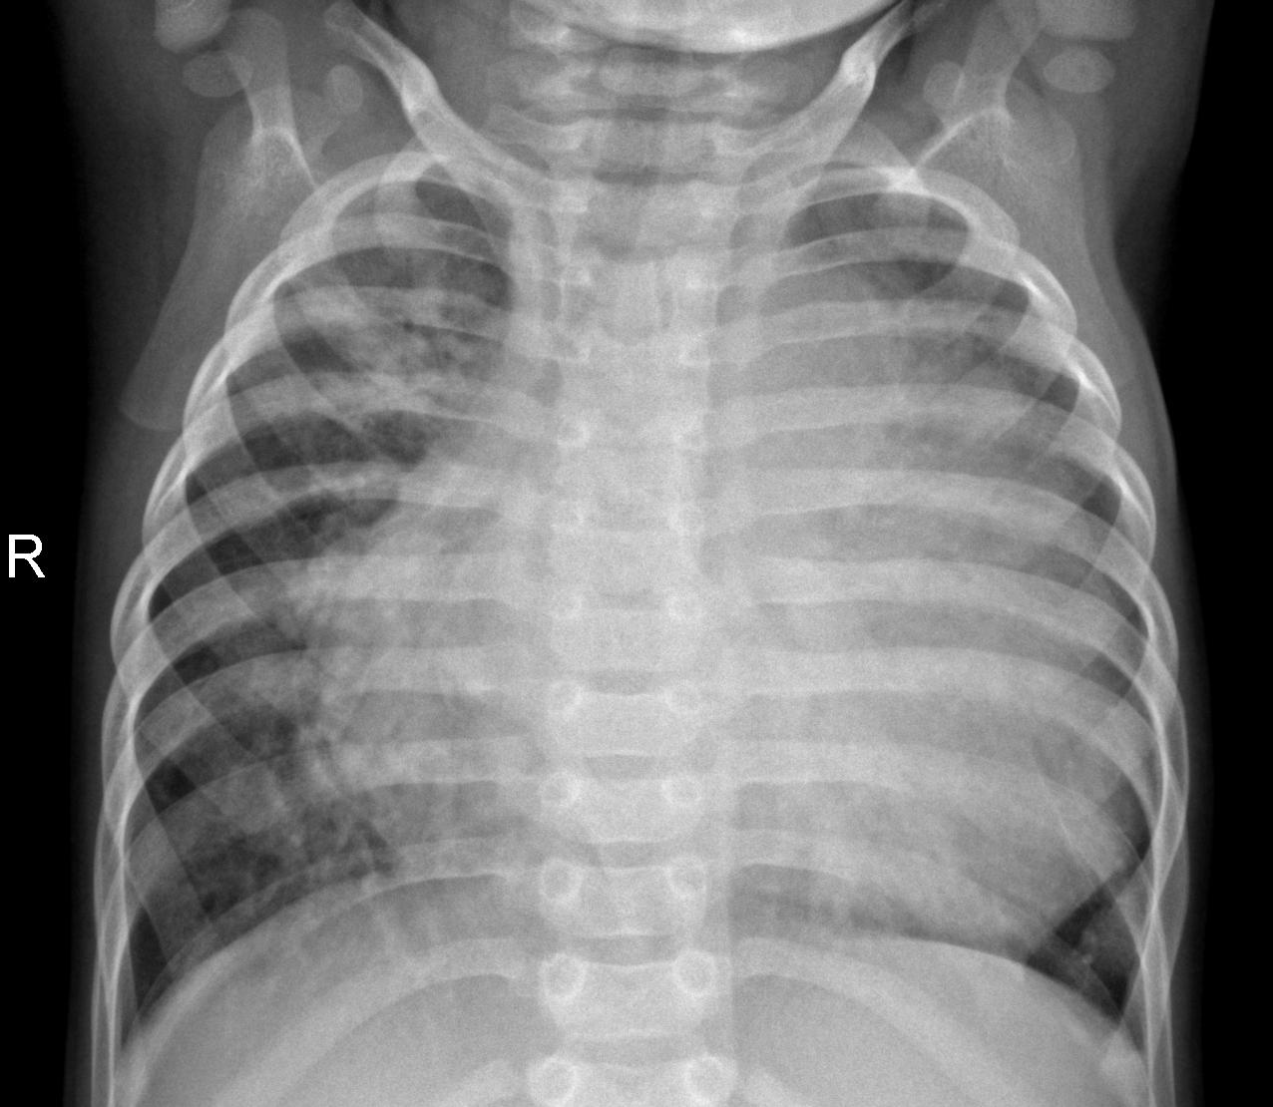
Implementation: Bridging Industry and Medicine
The GroundTruth Problem : MVTec typically expects pixel-level masks for P-AUROC. Our medical dataset provided only image-level labels.
The Solution : Dummy Masks" (Zero-Tensors). This allowed training scripts to focus purely on Image-level AUROC as the success metric
Notes:
So, how does SimpleNet actually handle all those tricky problems? Well, first it tweaks pre-trained features—basically fine-tuning what it already learned from big datasets so it really understands our kind of factory images. That way, it knows the data it’s looking at.
Then, instead of trying to make fake defective images, it does something clever—it adds small variations directly in the feature space. This makes detecting real defects way more reliable.
And to keep everything fast, it uses a lightweight discriminator—a sort of quick decision-maker that tells normal from abnormal almost instantly.
The coolest part? SimpleNet isn’t just for factories. It can spot anything unusual, anywhere. So it works for one-class novelty detection in all sorts of domains.

Slide 9
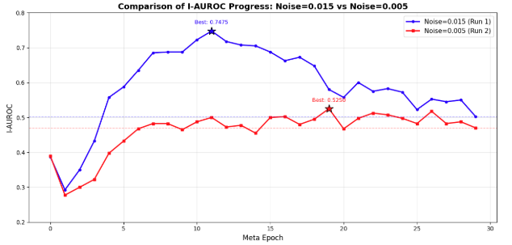
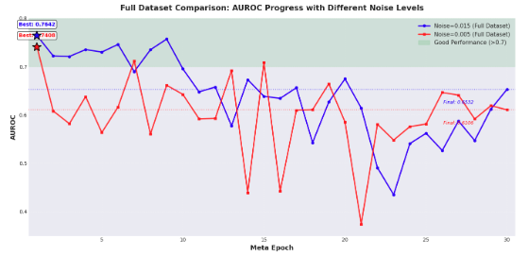


Visual Insight : The Noise Gap
0.764 Best I-AUROC Score
Trained on full datset around 1340 normal images with $σ$ = 0.005 and 0.015
Trained on only 100 normal images with $σ$ = 0.005 and 0.015

Slide 10


Final Verdict : Simplicity is Sophistication
Core Takeaways
Future Work
High Versatility: Minimal architectural changes to move from Industry to Medical data
Adaptive Noise : Based on the Usecase.
Rapid Deployment: Clinical triage ready using very few healthy samples.
Multi-Modal: Integrating clinical metadata alongside X-ray features.
Thank you ☺ !
Notes:
So, how does SimpleNet actually handle all those tricky problems? Well, first it tweaks pre-trained features—basically fine-tuning what it already learned from big datasets so it really understands our kind of factory images. That way, it knows the data it’s looking at.
Then, instead of trying to make fake defective images, it does something clever—it adds small variations directly in the feature space. This makes detecting real defects way more reliable.
And to keep everything fast, it uses a lightweight discriminator—a sort of quick decision-maker that tells normal from abnormal almost instantly.
The coolest part? SimpleNet isn’t just for factories. It can spot anything unusual, anywhere. So it works for one-class novelty detection in all sorts of domains.

Slide 11
State-of-the-Art Performance
99.6%
Detection AUROC
↑ 55.5% error reduction vs. PatchCore
98.1%
Localization AUROC
Precise pixel-level defect maps
77 FPS
Inference Speed
8× faster than PatchCore
9/15
Best on MVTec Categories
100% on hazelnut, metal nut, wood
Best accuracy + Fastest speed simultaneously!
Notes:
Now, let’s look at how well SimpleNet actually performs. In terms of detection, it achieves an impressive 99.6% AUROC—that’s a 55% error reduction compared to PatchCore, which is huge.
For localization, it reaches 98.1% AUROC, giving very precise pixel-level maps of defects. This means it doesn’t just detect anomalies—it shows exactly where they are, which is super important for things like manufacturing or medical imaging.
And it’s fast too! SimpleNet runs at 77 frames per second, about eight times faster than PatchCore, making it practical for real-time detection on the factory floor.
On top of that, it performs best on 9 out of 15 MVTec categories, even hitting 100% accuracy for hazelnuts, metal nuts, and wood. So, it’s not just accurate and fast—it’s versatile across different types of anomalies.

Slide 12






Applications & Current Scope
Applications :
Manufacturing Quality Assurance
Real-Time Quality Control Systems
Adaptable Across Product Lines
Current Scope :
Requires Per-Category Training
Dependency on Pre-trained Features
Fixed Noise Generation Strategy
Notes:
Following those results, let’s look at where SimpleNet can be applied. In manufacturing, it supports quality assurance by automatically detecting defects. It’s also perfect for real-time quality control systems, keeping production lines running smoothly. Plus, it’s adaptable across different product lines, so it can be used for a variety of factories.
There are a few technical considerations. SimpleNet requires per-category training, meaning a separate model for each product type. It relies on pre-trained features, which can introduce some domain bias, and it uses a fixed noise generation strategy, which could be improved for different kinds of anomalies."

Slide 13
Key Takeaways & Future Exploration
Key Takeaways:
    Feature-space synthesis > Image-space synthesis
    Domain adaptation crucial for pre-trained models
    Simplicity doesn't sacrifice performance
    Ready for industrial deployment TODAY
Multi-category learning
Few-shot adaptation
Multi-modal fusion
Future Exploration:
Notes:
To wrap up, here are the key takeaways from SimpleNet. First, generating anomalies in the feature space works better than doing it in the image space. Second, adapting pre-trained models to the target domain is crucial for good performance. Third, SimpleNet shows that simplicity doesn’t mean sacrificing accuracy. And finally, it’s ready for industrial deployment today.
Looking ahead, there’s exciting potential for future work—like multi-category learning, few-shot adaptation, and even multi-modal fusion. Thank you for listening!"

Slide 14


THANK YOU ☺
Puneetha Dharmapura Shrirama
https://github.com/puni-ram48/MADE-SS2024
Notes:
Thank you for your attention. For more information, you can visit my GitHub at https://github.com/puni-ram48/MADE-SS2024

Slide 15








Anomaly Detection Challenges & SimpleNet’s Fix
Challenges:
Reconstruction methods can fail to identify minor anomalies.
Synthetic anomalies in image space don’t match real-world defects.
Pretrained models, like those from ImageNet, introduce domain bias.
Embedding-Based (PatchCore, PaDiM) are memory-intensive and slow inference.
SimpleNet‘s Solution:
Feature adaptation reduces domain bias and improves accuracy.
Noise in feature space creates more realistic synthetic anomalies.
A lightweight discriminator detects anomalies efficiently and quickly.
One-class novelty detection extends beyond industrial defects..
Problem: Cannot collect enough labeled defect examples.
Notes:
Anomaly detection faces several challenges in real-world applications. First, reconstruction-based methods, like autoencoders, can sometimes “generalize” well enough to reconstruct anomalies, leading to false positives.
Second, synthetic anomalies created in image space often don’t look realistic, making it harder to differentiate real defects from artificial ones.
Third, features from ImageNet pre-trained models can introduce domain bias, especially in industrial settings, where the image distribution is different.
Finally, many current anomaly detection models are computationally heavy, making real-time inference difficult.
SimpleNet addresses these issues by adapting pretrained features to match the target domain, generating anomalies directly in feature space to reduce the gap between real and fake defects, and using a simple yet powerful discriminator for fast and accurate detection.
Furthermore, it extends its capabilities to One-Class Novelty Detection, proving its broader applicability beyond industrial inspection.

Slide 16



Applications of SimpleNet
Manufacturing &
Industrial
HealthCare Imaging
Anomaly Detection
Security & Surveillance
Retail & Consumer Goods
From detecting defects to defending data — anomaly detection safeguards every domain
Notes:
SimpleNet is a versatile framework for image-based anomaly detection, with impactful use cases across various industries.
In manufacturing, it identifies subtle defects such as micro-cracks on metal parts and surface imperfections in automotive components or electronics. This ensures real-time quality control and improves product reliability.
In healthcare imaging, SimpleNet plays a crucial role in early detection of tumors in mammograms and lung nodules in X-rays, providing life-saving insights for radiologists.
In retail and consumer goods, it is applied to detect defective products and packaging errors, ensuring quality assurance across industries, from electronics to food packaging.
Lastly, in security and surveillance, SimpleNet analyzes video footage to detect anomalous behaviors, such as unauthorized access in restricted areas, providing enhanced security in critical environments.”
“These applications highlight the power of SimpleNet to solve real-world problems with high accuracy and real-time performance.”
###closing statement: From detecting defects to defending data — anomaly detection safeguards every domain.

